Slide 1
CS 4530: Fundamentals of Software Engineering Module 1, lesson 2 — Course Mechanics
Rob Simmons
Khoury College of Computer Sciences
© 2025 Released under the CC BY-SA license

Slide 2
How you’ll learn
Lectures and in-class discussion
Slides will be available on course website
Tutorials
More in-depth discussions than we have time for in class.
Primary “reading” for the course in lieu of a textbook
Practice activities (x?)
Usually done in groups, usually in-class
Focused on giving specific practice with technologies we use
Individual projects (x3)
Get you used to the project codebase, practice skills
Group project

Slide 3

Welcome to the strategy.town team!
We want to be the #1 spot for people who want the social experience of watching Twitch™ but for turn-based games
(Demo)
CS 4530 is part traditional academic course, part “having a new software job” simulation
The individual projects are like “onboarding” projects, and the group project is a scaled-down version of actual product delivery
Course staff have a secondary role as part of this simulation
Notes:
(Quick demo)

Slide 4
How you’ll be evaluated
Class participation and practice activities (15%)
Midterm (15%)
Individual projects (30%, not evenly weighted)
Team project (40%)
Includes team evaluation and surveys
To pass, you must also:
Do most of the individual projects
Demonstrate understanding of concepts in midterm
Demonstrate ability to do software development & engineering in group project

Slide 5
Technology
We will use:
TypeScript as implementation language
Vitest as Testing Framework
Visual Studio Code as our IDE
React for webapps
GitHub Projects for Project Management
GitHub Actions / Netlify /Heroku / Render for CI/CD
Also, other miscellaneous tools

Slide 6
Grade Appeal Policy
If you have concerns regarding the grading of your work, please let us know within two class days.
Gradescope-delivered grades can be appealed in Gradescope
Appeal mechanism will be given for other assignments
Do not post on Piazza or email your TA or instructor
If your regrade request is closed and you feel that the response was not satisfactory, you may appeal to the instructor via email within 24 hours

Slide 7
Late Policy
Individual projects, practice activities, and individual deadlines for group work:
10% will be deducted for late individual work turned in within 24 hours after the due date
Individual work and practice activities submitted more than 24 hours late will receive a zero
If you're worried about being busy around the time of a HW submission, please plan ahead and get started early
If you have an accommodation from Disability Access Services (previously DRC), you must request it from the instructors separately for each assignment or exam.
Group work:
No late submissions allowed for any group work team submissions
DAS or DRC Accommodations are usually NOT available for Group Assignments (please work with instructor, we’ll make something work!)

Slide 8
Academic Integrity (1)
Students must work individually on all homework assignments.
We encourage you to have high-level discussions with other students in the class about the assignments. You shouldn’t be inspecting the code or writing of other students though. Copying any part of another student's assignment is strictly prohibited.
Small snippets of publicly posted code are allowed with attribution
If you steal someone else's work, you fail the class.
You are responsible for protecting your work. If someone uses your work, with or without your permission, you fail the class.

Slide 9
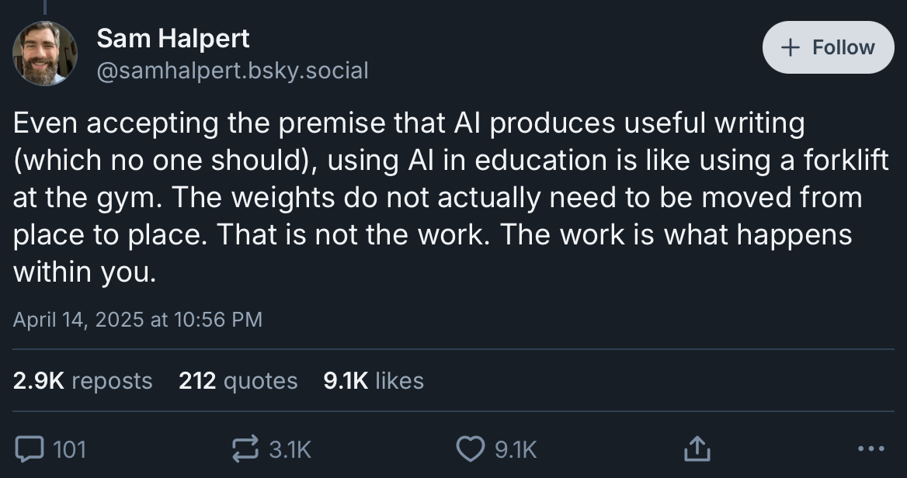
Academic Integrity (2)
LLM-alikes defeat the purpose of practice assignments and individual projects #1 and 2.
There are academic integrity concerns with fundamentally un-attributable work, but we all seem to be pretending that’s not a thing.
You will have an opportunity to practice operating forklifts, if you want, in individual project #3.
https://bsky.app/profile/samhalpert.bsky.social/post/3lmt3coqvqk2w
Still thinking about group project; interested in your thoughts.

Slide 10
Academic Integrity (3)
We reserve the right to “interview” you to gauge your understanding (with possible grade adjustments)
If you are concerned that by reusing and attributing that copied code it may appear that you didn't complete the assignment yourself, then please raise a discussion with the instructor.
If you are in doubt whether using others' work is allowed, you should assume that it is NOT allowed unless the instructor confirms otherwise.

Slide 11
Communication
Canvas site
Best source for grades, links to everything else
Course web page (https://neu-se.github.io/CS4530-Summer-2025/)
Assignments, important notices, etc., will appear here
Piazza (see Canvas for link)
Questions about content, policies, assignments, projects, etc. are better asked on Piazza, so everybody gets the same answers.
Contacting the Instructor
For private questions about your individual situation, please email me directly (do NOT use Canvas messages – they may not get through to the instructor)
Please put CS4530 in the subject line so your message does not get overlooked
I encourage all students to “Meet” with me at least once!
Office Hours
Usually in person after class in this room, starting tomorrow
TA Office Hours are held via Khoury Office Hours App

Slide 12
Review
It’s the end of this module, so you should be able to:
Explain in general terms what software engineering is
List your weekly obligations as a student
List the requirements for completing the course

